Slide 1
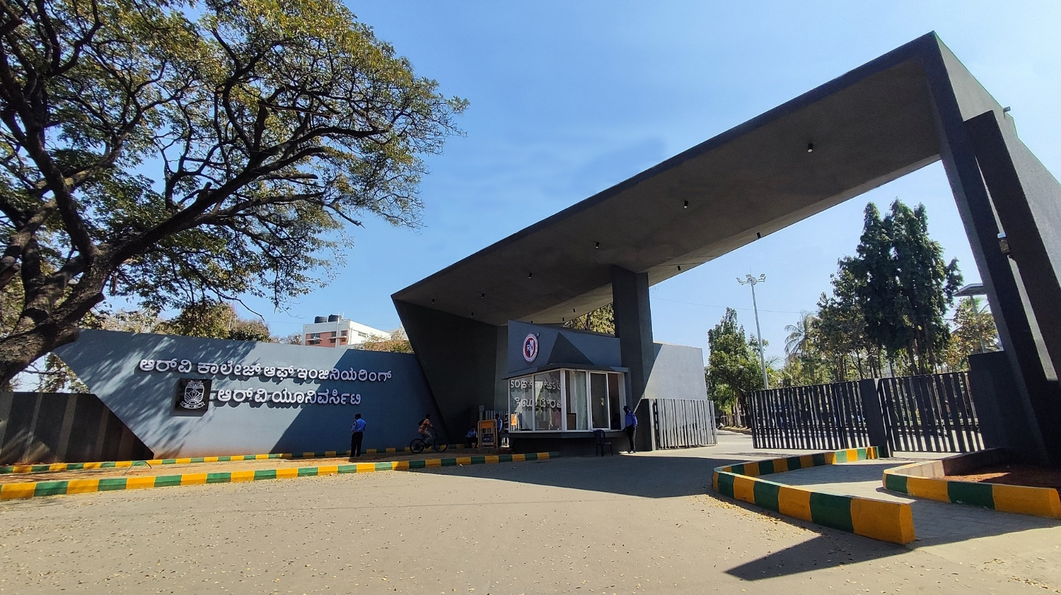
SecureX
CSE cluster

Slide 2

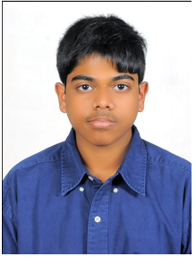



SecureX
K V DAIWIK
1RV24CS114
K.SAI JASWANTH REDDY
1RV24CS121
JETTY VIJAYA SAI
1RV24CS111

Slide 3

EL Phase-III
Presentation Outline
Introduction
Problem Statement
Objectives
Literature Review
Methodology
Design and Implementation
Technical components and Stack
Results
Challenges Faced
Final Outcomes
Applications
Future Scope
Conclusion
References

Slide 4

Introduction
Overview:
Hybrid Huffman–LZW Compression is a lossless data compression project that combines LZW dictionary coding with Huffman entropy coding to reduce file size while preserving all information. The system is implemented as a Python + Flask web application that lets users upload files, compress/decompress them, and view compression statistics. It is designed as an experiential DSA project to showcase real use of hashing, tries, heaps, and binary trees in a practical, high‑efficiency compression pipeline.
Importance:
Ensures lossless storage and transmission, so decompressed data is exactly identical to the original, which is critical for code, documents, and medical or scientific data.
Reduces file size and improves efficiency of storage and network bandwidth, effectively increasing usable capacity without changing hardware.
Demonstrates real use of DSA concepts like hash tables, tries, heaps, and binary trees, inside a working system, strengthening conceptual understanding beyond theory.

Slide 5





Problem Statement
Problem statement:
Design a transparent, high-efficiency lossless compressor that combines LZW and Huffman coding, overcoming the limitations of black-box tools and naïve, slow Python implementations.
Context of the Problem:
Data volumes are rapidly increasing, and existing compressors hide how core DSA concepts are applied, limiting both performance tuning and educational value in academic settings.
Significance of Addressing the Problem:
Improves storage and transmission efficiency by significantly reducing file size without any information loss, which is vital for code, documents, images, and other critical data.
Provides a practical platform to understand and visualize core DSA concepts—hashing, tries, heaps, and binary trees—within a real hybrid compression system rather than only in theory.

Slide 6


Objectives
Our primary objective with hybrid Huffman–LZW lossless compression system is both efficiency in practice and transparency for learning core Data Structures and Algorithms. The system aims to reduce storage and transmission costs while guaranteeing exact reconstruction of the original data. At the same time, it serves as an experiential learning platform that exposes internal data structures such as dictionaries, heaps, and trees in a realistic application context.
Other objectives include:
To build a fully lossless hybrid compressor that combines LZW dictionary coding and Huffman entropy coding for generic binary files.
To optimize the Python implementation using appropriate data structures, buffered I/O, and bit-level operations for better speed and memory behavior.
To provide a web-based interface that allows users and students to compress/decompress files and observe key metrics, reinforcing DSA concepts through practice.

Slide 7






Literature Review
PAPER | PAPER SUMMARY
R. Hasan, “Data Compression using Huffman based LZW Encoding Technique,” Int. J. Scientific & Engineering Research, vol. 2, no. 11, Nov. 2011. | This paper proposes a hybrid lossless compression scheme that applies Huffman coding and LZW together and experimentally compares it against standalone Huffman and standalone LZW. Results show that the hybrid “Huffman-based LZW” can reduce files to about 38–40% of their original size, giving a better compression ratio than either method alone. It also discusses scenarios where LZW or Huffman individually perform best and quantifies the relative improvement of the hybrid method.
D. Kaur and K. Kaur, “Huffman Based LZW Lossless Image Compression Using Retinex Algorithm,” Int. J. Advanced Research in Computer and Communication Engineering, vol. 3, no. 3, 2014. | This work targets image compression by first applying Huffman and LZW-based lossless compression, then using the Retinex algorithm to enhance the contrast and visual quality of the compressed images. The authors report increased compression ratio along with improved sharpness and color rendition after Retinex enhancement, demonstrating that compression and post-processing can be combined effectively for image applications.
P. N. A. A. M. Sabri et al., “Improvement of Lossless Text Compression Methods using a Hybrid Method by the Integration of RLE, LZW and Huffman Coding Algorithms,” Int. J. Software Engineering & Applications, vol. 15, no. 5, 2024. | This paper integrates three classical algorithms—Run-Length Encoding (RLE), LZW, and Huffman—into a single hybrid pipeline aimed at improving lossless text compression. Experiments show that the hybrid method achieves better compression ratios and smaller compressed file sizes compared to using RLE, LZW, or Huffman alone, highlighting the benefit of multi-stage compression designs.
A. Gopinath and M. Ravisankar, “Comparison of Lossless Data Compression Techniques,” in Proc. Int. Congress on Information and Communication Technology, 2020. | This study presents a comprehensive performance comparison of several lossless compression methods by applying them to data files and evaluating compression ratio, speed, space saving, and execution time. The work emphasizes how algorithm choice affects storage and communication efficiency, and it provides a useful benchmark context for positioning newer hybrid methods.
“Hybrid Lossless Compression Technique,” Dept. CSE, Jaypee University (thesis). | This document proposes and analyzes a hybrid lossless compression technique that combines multiple coding stages (including Huffman and dictionary-based methods) to improve performance. It discusses design choices, implementation details, and experimental results, making it a relevant reference for hybrid schemes similar to a Huffman–LZW pipeline.​

Slide 8
Methodology
The methodology follows a two-stage hybrid lossless compression pipeline implemented in Python and Flask-based web interface. In the first stage, LZW converts repeated byte patterns into integer codes using a dynamically growing dictionary. In the second stage, Huffman coding builds a prefix-free code over these LZW codes to generate a compact bitstream. The system is evaluated on different file types to measure compression ratio, time, and robustness, while simultaneously illustrating key DSA concepts such as hashing, tries, heaps, and binary trees in a practical setting.
Source Side: Web UI uploads the file, backend reads it as a byte stream, applies LZW encoding followed by Huffman encoding, and produces a compressed file with a self-contained header.
Destination Side: Backend reads the compressed file, reconstructs the Huffman codes, decodes the LZW code sequence, rebuilds the original bytes, and returns the decompressed file to the user.

Slide 9
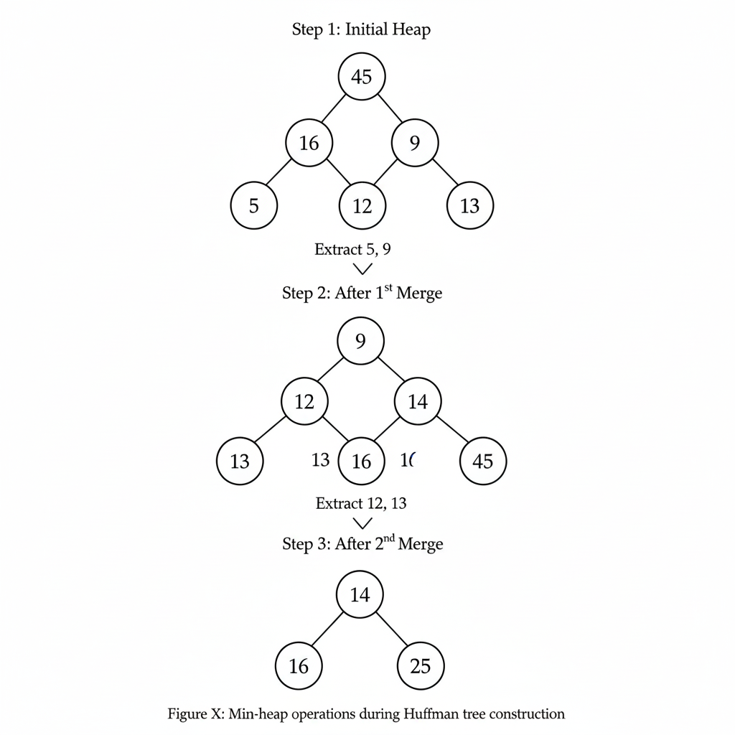
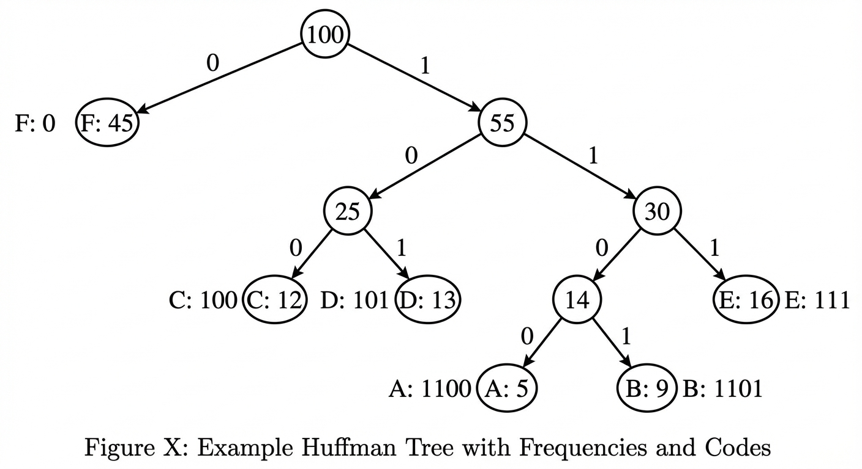
Data Structure used
Min-heap operations in Huffman tree construction repeatedly extract the two nodes with the smallest frequencies, merge them into a new internal node whose frequency is their sum, and push this node back into the heap. This process continues until only one node remains in the min-heap, which becomes the root of the completed Huffman tree.

Slide 10
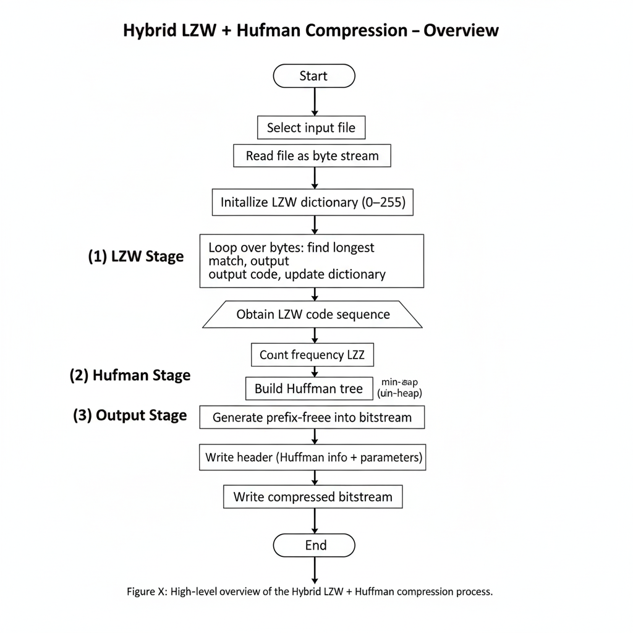
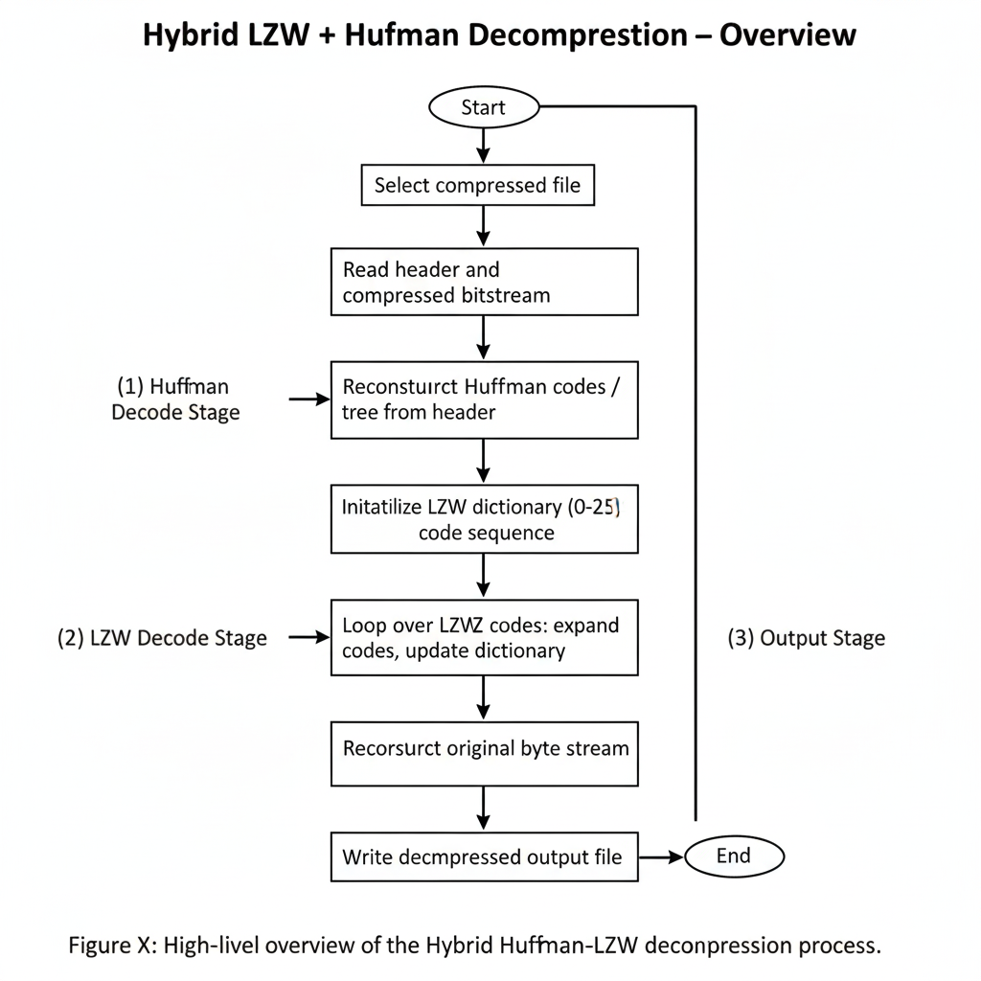



Flowchart

Slide 11







Design and Implementation
The system follows a modular hybrid architecture that separates LZW, Huffman, and I/O logic inside a Python + Flask web service. A 16 bit LZW dictionary performs pattern-based compression, while a Huffman module uses a min-heap to build an optimal binary tree and assign prefix-free codes to the LZW output, all wrapped by a bit-IO layer that handles buffered bit-level reads and writes. The Flask backend exposes these modules through upload/download endpoints, and a frontend lets users submit files, trigger compression/decompression, and view metrics such as compression ratio and processing time.
Source Side: The upload endpoint reads the input file as a byte stream, passes it through the LZW encoder and then the Huffman encoder, packs the result into a custom self-contained “.hy” file (header + bitstream), and returns it to the user along with basic statistics.
Destination Side: The decompress endpoint parses the header, reconstructs the Huffman codes and tree, decodes the bitstream back into LZW codes, runs the LZW decoder to rebuild the original bytes, and then streams the reconstructed file back to the client, verifying lossless round-trip behavior.

Slide 12


Technical components and Stack
Technical Components
Core Algorithms:
LZW encoder/decoder with a 16 bit dynamic dictionary for pattern-based compression.
Huffman encoder/decoder using a min-heap and binary tree for prefix-free entropy coding.
Support Modules:
Bit I/O layer for buffered bit-level read/write of the compressed stream.
Custom header formatter to store metadata (magic bytes, flags, Huffman info, lengths)."
Application Layer:
Flask backend exposing endpoints for compress/decompress and basic benchmarking.
HTML/CSS/JavaScript frontend for file upload and display of compression statistics (ratio, size, time).
Technical Stack
Language: Python 3.x (algorithm implementation, server logic).
Web Framework: Flask (routing, request handling, integration with templates).
Frontend: HTML5, CSS3, vanilla JavaScript; optional Chart.js for visualizing compression ratios and timings.
Data Structures : dict (hash table) for LZW dictionary, heap for Huffman min-heap, custom node classes for binary tree representation.

Slide 13



Results
The Hybrid Huffman–LZW compressor achieves compression ratios in the range of roughly 3.4× to 4.5×, meaning the compressed files are about 22–29% of the original size on the tested datasets.
When compared to classical algorithms, the hybrid method matches or outperforms most of them in compression ratio while keeping memory usage moderate.
Compression and decompression speeds are competitive for a Python implementation, offering a good balance between performance and implementation simplicity; memory usage remains acceptable due to the fixed 16‑bit dictionary and efficient bit-packing.
Lossless behavior is fully preserved: round-trip tests confirm that decompressed output is identical to the input, and edge cases such as empty or single-symbol files and dictionary-limit scenarios are handled correctly.

Slide 14
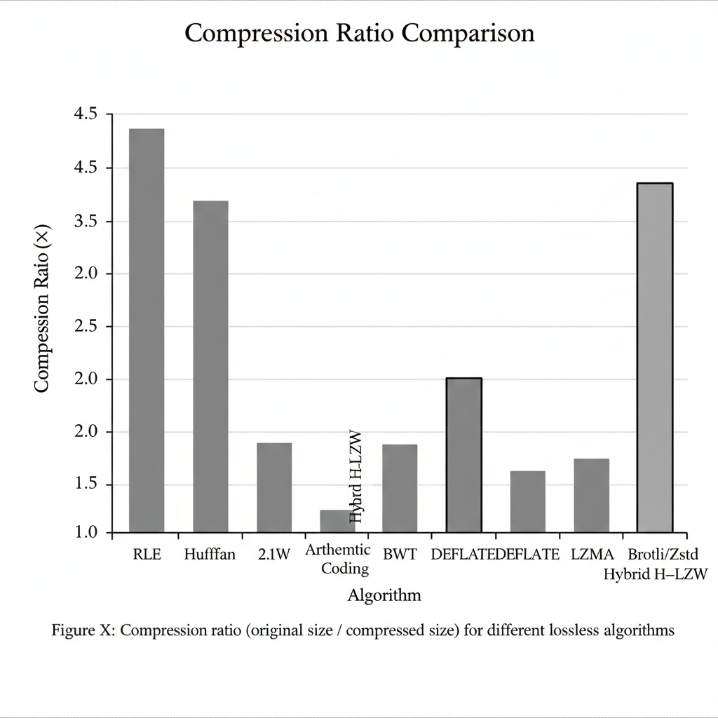
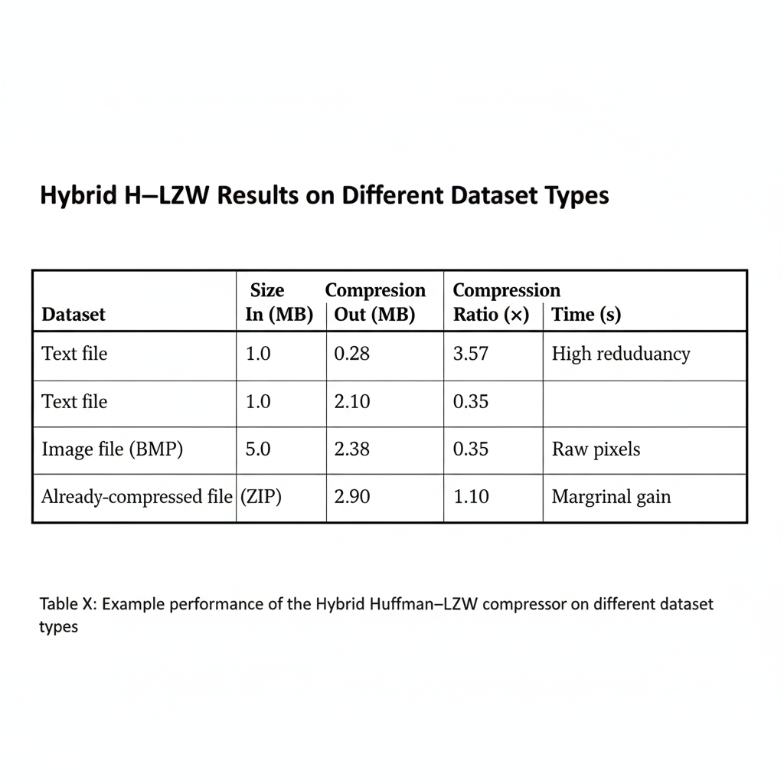
Results

Slide 15


Challenges Faced
Balancing performance with clarity in Python was challenging, especially avoiding slow string operations and excessive function call overhead while still keeping the code easy for students to read and understand.
Designing a robust file format and header that stores all Huffman and LZW metadata correctly, and still remains simple enough for deterministic decoding and debugging, required several iterations.
Handling edge cases such as empty files, single-symbol inputs, and dictionary-limit conditions without breaking the compressor–decompressor symmetry was non-trivial and needed careful testing.

Slide 16

Final Outcomes
The project results in a robust hybrid Huffman–LZW compression system that bridges academic theory and practical deployment through a fully functional web application. Experiments confirm that the approach achieves high compression ratios with reasonable speed and memory usage, comparing favorably to several classical lossless algorithms while preserving strict losslessness.
By making the internal structures—LZW dictionary evolution, Huffman trees, and encoded bitstreams—visible and testable, the system also serves as a strong experiential platform for understanding core data-structure concepts.
Provides an end-to-end Flask-based workflow for uploading, compressing, decompressing, and analyzing arbitrary binary files.
Demonstrates reliable round-trip reconstruction and robust handling of edge cases across diverse input types.
Offers a modular foundation that can be extended with streaming, WebAssembly offloading, or specialized domain compressors in future iterations

Slide 17


Future Scope
WebAssembly-Based Client Compression: Port the core LZW + Huffman pipeline to WebAssembly so that large files can be compressed directly in the browser, reducing server load and improving responsiveness for end users.
Parallel Block-Wise Engine: Introduce multi-threaded, block-wise compression and decompression for very large datasets (logs, backups), enabling better utilization of multi-core CPUs while preserving exact losslessness.
Adaptive, Content-Aware Modes: Design adaptive strategies that choose parameters (dictionary reset policy, block size, or even fallback algorithms) based on file type and redundancy patterns, improving performance on diverse domains such as medical images or text corpora.
Streaming and API Integration: Extend the system with true streaming support and REST APIs so that other applications or microservices can use the hybrid compressor in real time (e.g., for backups, telemetry, or edge devices).

Slide 18
Conclusions
Addresses a real storage and bandwidth challenge: Reduces the size of text and binary files without losing any information, making data handling more efficient.
Treats compression as transparent, not a black box: Exposes LZW dictionaries, Huffman trees, and bitstreams so the internal logic is understandable and verifiable.
Combines strong efficiency with learnability: Achieves competitive compression ratios and speeds while remaining simple enough for students to study and modify.
Strengthens DSA understanding in practice: Shows how hashing, tries, heaps, and binary trees work together inside a real system, beyond textbook examples.

Slide 19


References
D. J. Kadhim, M. F. Mosleh and F. A. Abed, “Exploring Text Data Compression: A Comparative Study of Adaptive Huffman and LZW Approaches,” BIO Web of Conferences, vol. 72, 2024.
D. Kaur and K. Kaur, “Huffman Based LZW Lossless Image Compression Using Retinex Algorithm,” Int. J. Advanced Research in Computer and Communication Engineering, vol. 3, no. 3, pp. 5455–5460, 2014.
L. A. Fitriya and T. W. Purboyo, “A Review of Data Compression Techniques,” International Journal of Engineering and Technology (or equivalent venue; confirm from PDF), 2019.
U. Holtz, Lossless Data Compression: Theory and Practical Methods. Amsterdam, Netherlands: Elsevier, 2012.
R. Hasan, “Data Compression Using Huffman Based LZW,” in Proc. Int. Conf. , 2011.
H. Mohammadi and co-authors, “A Novel Hybrid Medical Data Compression Using Huffman and LZW,” Journal of Interdisciplinary Mathematics, vol. 25, no. 8, pp. 2049–2067, 2023.
A. N. M. Hasan, “Data Compression Using Huffman-Based LZW,” Semantics Scholar Repository (technical report / preprint), 2017.
M. B. Ibrahim, “Implementation of Enhanced Data Compression Using Hybrid Huffman–LZW and Cryptographic Techniques,” Ph.D. dissertation, Dept. Computer Science, (Univ. name as in PDF), 2021.
G. Shrividhiya, K. S. Srujana, S. N. Kashyap and C. Gururaj, “Robust Data Compression Algorithm Utilizing LZW Framework Based on Huffman Technique,” in Proc. Int. Conf. Emerging Smart Computing and Informatics (ESCI), 2021.
L. A. Sabri, A. A. M. Abas and F. Azzali, “Analysis of Lossless Compression Using Huffman Coding and LZW,” Journal of Advanced Research in Computing and Applications, vol. 10, no. 1, pp. 1–10, 2025.
A. Gopinath and M. Ravisankar, “Comparison of Lossless Data Compression Techniques,” in Proc. Int. Congress on Information and Communication Technology, 2020.
Y. Zhang, L. Xiao, D. Hua, H. Chen and H. Jin, “A LiDAR Data Compression Method Based on Improved LZW and Huffman Algorithm,” in Proc. Int. Conf. Electronics and Information Engineering, 2010.
D. F. Djusdek, H. Studiawan and T. Ahmad, “Adaptive Image Compression Using Adaptive Huffman and LZW,” in Proc. Int. Conf. Information Communication Technology and Systems (ICTS), 2016.
M. Kulkarni, D. Jagdale, R. Joshi, A. Joshi and S. Kadam, “Text Compression Techniques: A Study of LZW, RLE, Huffman, and Extended Huffman Coding,” in Smart Innovation, Systems and Technologies, Springer, 2025.
U. Jayasankar, “A Survey on Data Compression Techniques,” Computer Communications, vol. 190, pp. 220–234, 2022.
A. Preethi and S. Lakshmi, “Data Compression Using Combination of Huffman and LZW Technique,” Int. J. Applied Engineering Research, vol. 10, no. 12, pp. 32845–32850, 2015.
M. Iqbal and A. Khaleel, “Medical Image Compression Techniques: A Review,” TELKOMNIKA Telecommunication, Computing, Electronics and Control, vol. 19, no. 3, pp. 1017–1027, 2021.
P. N. A. A. M. Sabri and co-authors, “Improvement of Lossless Text Compression Methods using a Hybrid of Huffman, RLE and LZW Algorithms,” International Journal of Software Engineering & Applications (IJSEA), vol. 15, no. 5, pp. 17–32, 2024.
M. Fauzan et al., “Performance Evaluation of Efficient Hybrid Compression Techniques,” arXiv preprint arXiv:2504.20747, 2025.
S. Shukla, “Comparative Analysis of Lossless Compression Algorithms,” International Journal of Innovative Research in Computing, vol. 6, no. 2, pp. 45–52, 2022.

Slide 20



